Slide 1
Chemotaxis Chemical Concentration with CFD
Tim Davison
Advisors:
Dr. Nickels, Dr. Nguyen

Slide 2
Introduction
This project: Uses computational fluid dynamics to model interactions of the chemotaxis performing robot with the environment (Colloidal Lattice Boltzmann)
Model a chemical source with wind by solving advection/diffusion equations
Method computes concentration at each point in the environment and feeds to existing rapid cell/LBM controller

Slide 3
Objectives
Understand existing CLB MATLAB code coupled with Rapid Cell
Generate solution for 2D advection/diffusion equation to output concentration with MATLAB PDE Toolbox or other, pre-existing PDE Solver
Implement solution into existing Rapid Cell code using output from LBM
Testing and validation
Document and report results

Slide 4
Objectives
Understand existing CLB MATLAB code coupled with Rapid Cell
Generate solution for 2D advection/diffusion equation to output concentration with MATLAB PDE Toolbox or other, pre-existing PDE Solver
Implement solution into existing Rapid Cell code using output from LBM
Testing and validation
Document and report results
This became testing and validation cont.
Also completion of LBM coupling

Slide 5
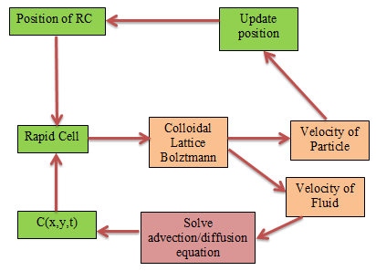

Slide 6



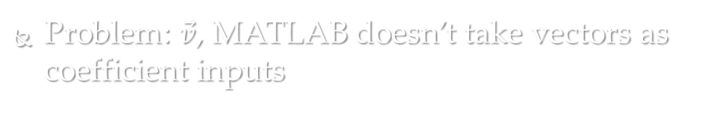
Trying to solve in MATLAB
Advection/diffusion equation
$$\frac{∂C}{∂t}=D\left(\frac{∂^{2}C}{∂x^{2}}+\frac{∂^{2}C}{∂y^{2}}\right)−\left(\vec{v_{x}}\frac{∂C}{∂x}+\vec{v_{y}}\frac{∂C}{∂y}\right)+ f$$
MATLAB’s parabolic PDE form:
-$\left(a\frac{∂C}{∂x}+b\frac{∂C}{∂y}\right)$
$$\frac{∂C}{∂t}−D\left(\frac{∂^{2}C}{∂x^{2}}+\frac{∂^{2}C}{∂y^{2}}\right)+au=f$$
Problem: $\vec{v}$, MATLAB doesn’t take vectors as coefficient inputs

Slide 7
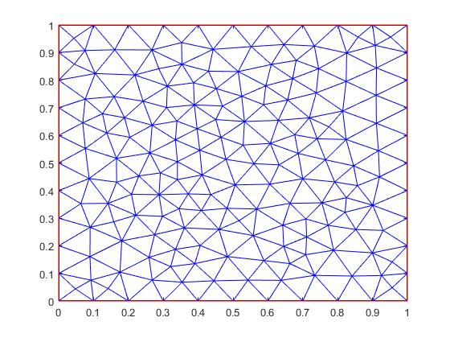
Solving PDE
Get velocity field output from LBM
Compute centroids of triangles used for mesh
Use meshgrid to interpolate velocity field to centroids
Evaluate and create column of f coefficients
Solve PDE

Slide 8
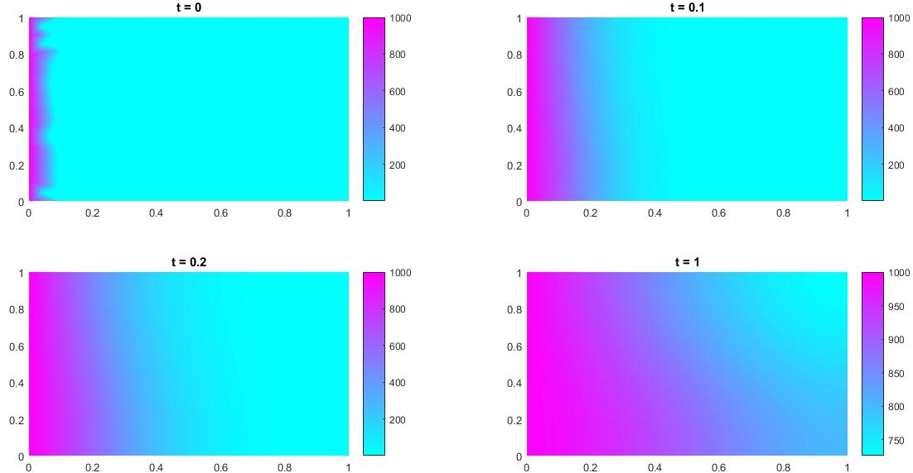
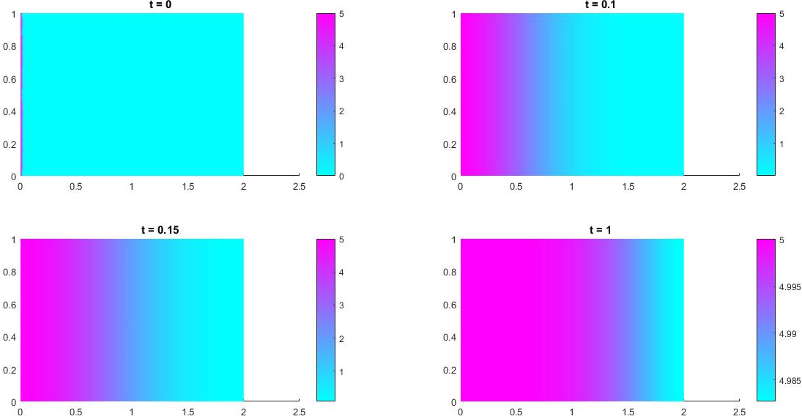
Results

Slide 9

Why?
Diffusion coefficient is too high
Left side of wall as constant concentration means
Need to reduce size of source
~ 0
$$\frac{∂C}{∂t}=D\left(\frac{∂^{2}C}{∂x^{2}}+\frac{∂^{2}C}{∂y^{2}}\right)−\left(\vec{v_{x}}\frac{∂C}{∂x}+\vec{v_{y}}\frac{∂C}{∂y}\right)+ f$$

Slide 10
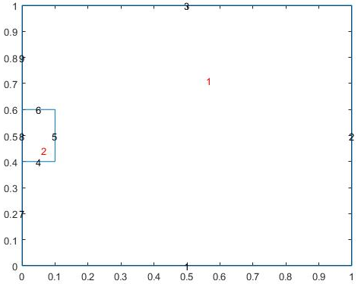
Solving this Problem
Constant concentration

Slide 11
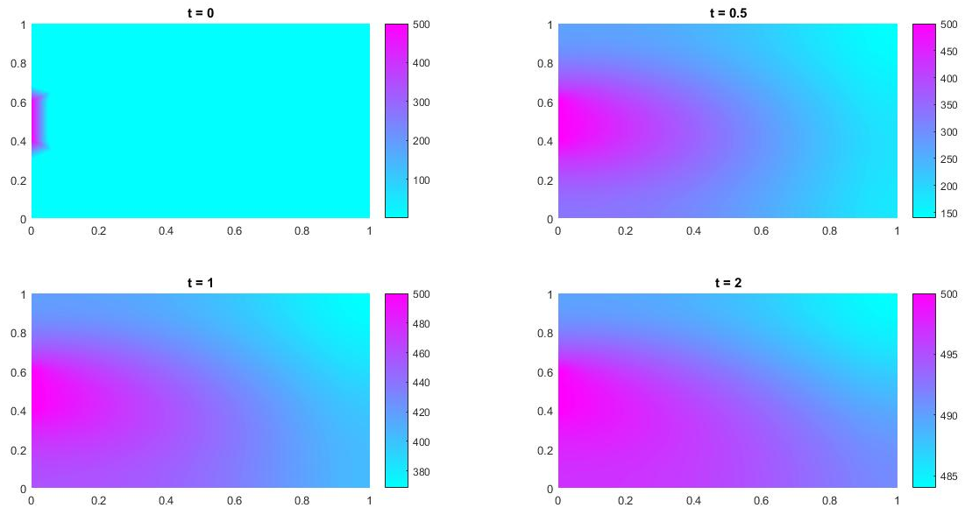
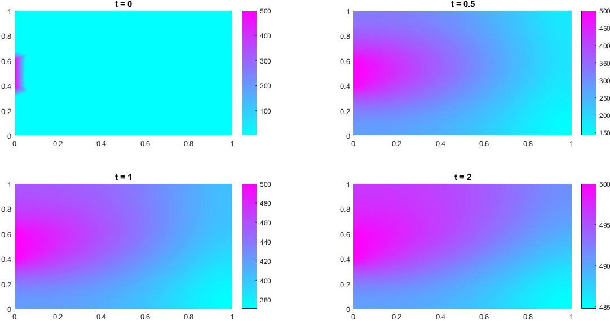
Results

Slide 12
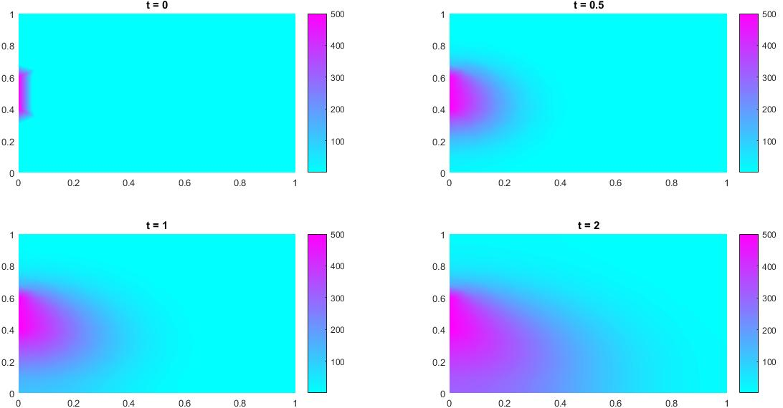
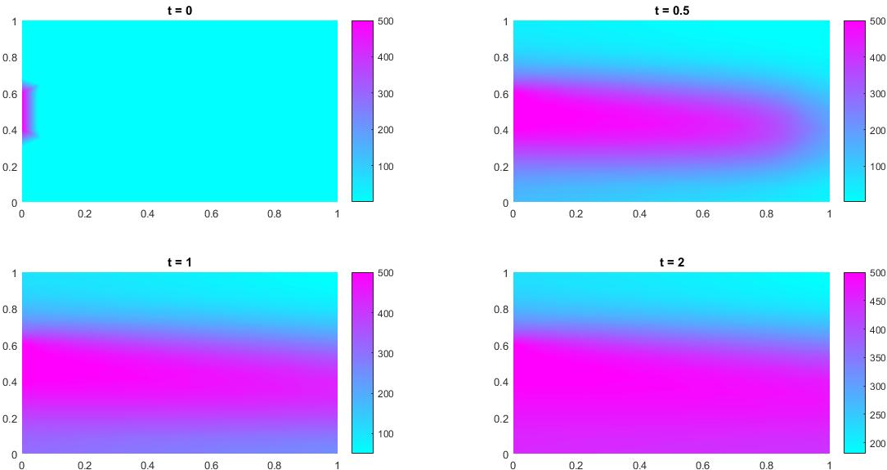
Results- low diffusion

Slide 13
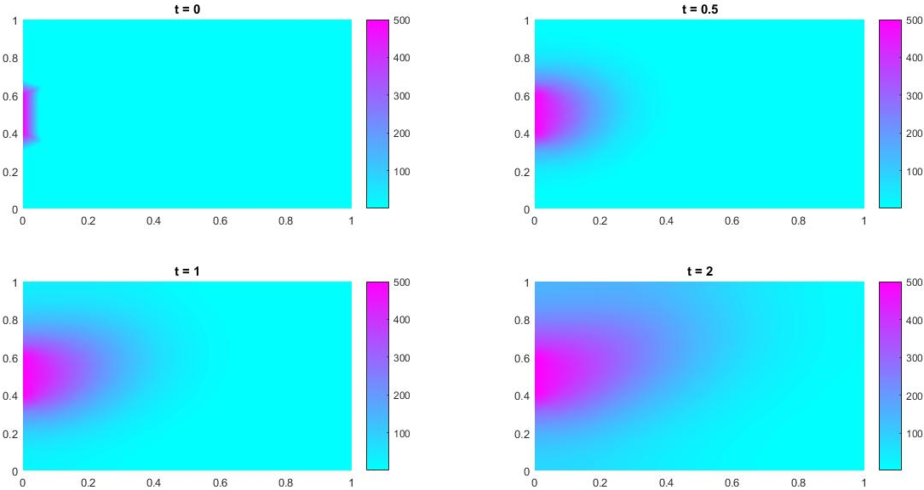
Results- low diffusion (LBM)
LBM velocity field

Slide 14
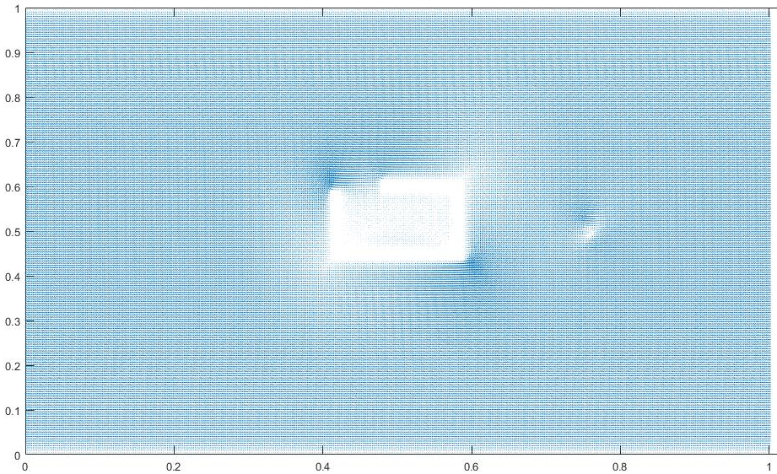
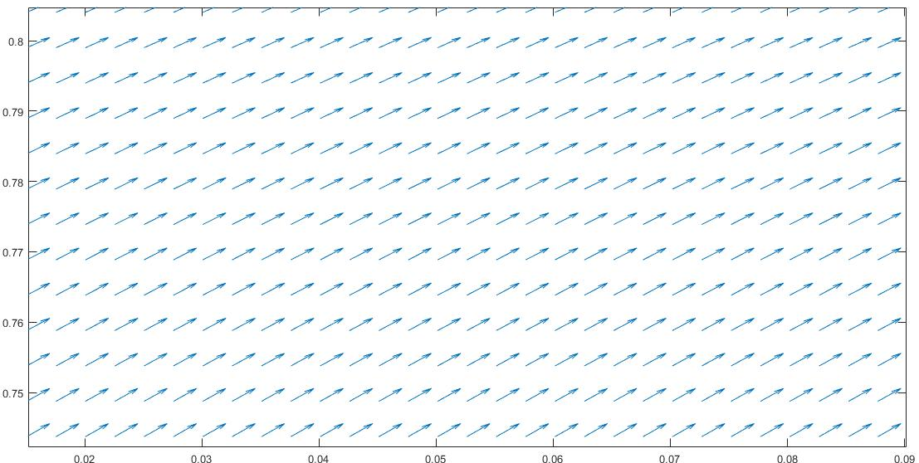
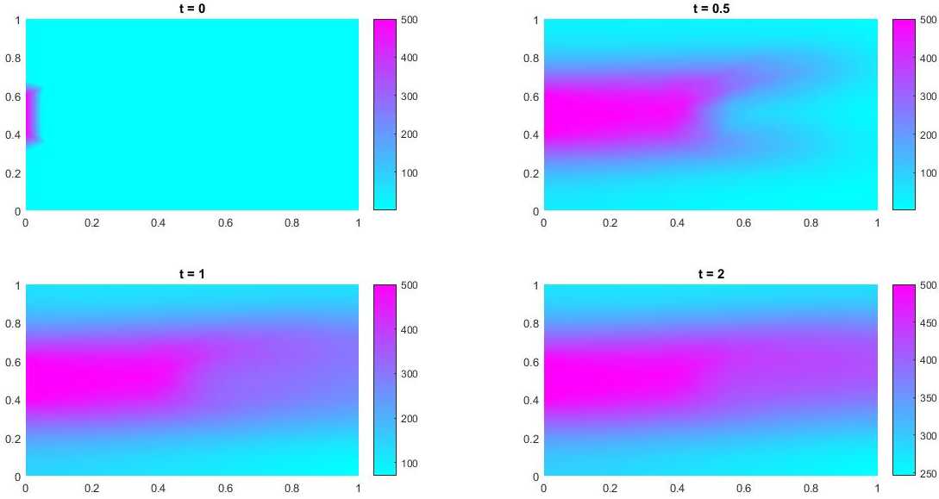
Results- with object

Slide 15
Coupling with LBM/rapid cell
Rapid cell runs in 1 second increments
Get initial velocity field from LBM
Run PDE solver to get concentration for ten 0.1 second steps
Run rapid cell for one time step to allow robot movement
Run PDE solver for ten steps with new velocity field
Use previous concentration as initial condition

Slide 16
Conclusions
My previous solution to the PDE wasn’t wrong, my boundary conditions were misleading
Going to take some altering of parameters to find balance for rapid cell (but it runs without failing)

Slide 17
Questions?

